Slide 1

Unit-4 Partial Derivatives
Mathematics-I (M-I)
GTU # 3110014
Prof. Darshan R. Pipaliya
Humanities & Science Department
darshan.pipaliya@darshan.ac.in
8160597689

Slide 2
OUTLINE
Method:1
Limit of Function of Two Variables
Method:2
Continuity of Function of Two Variables
Method:3
Partial Derivatives
Method:4
Chain Rule
Method:5
Implicit Function
Method:6
Tangent Plane and Normal Line

Slide 3
OUTLINE
Method:7
Local Extreme Values
Method:8
Lagrange’s Multipliers
Method:9
Gradient
Method:10
Directional Derivative

Slide 4

Method:1
Limit of Function of Two Variables

Slide 5


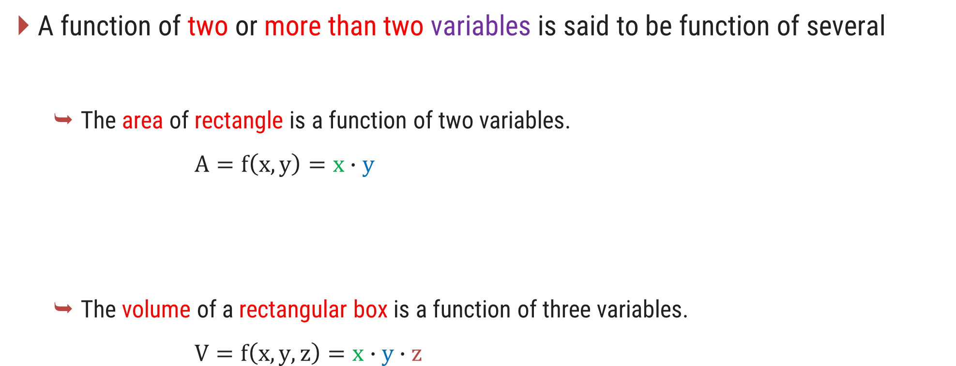



Function of Several Variables
A function of two or more than two variables is said to be function of several
The area of rectangle is a function of two variables.
$$A=f\left(x, y\right)=x∙y$$
The volume of a rectangular box is a function of three variables.
$$V=f\left(x, y, z\right)=x∙y∙z$$
variables.
$$y$$
$$x$$
$$y$$
$$z$$
$$x$$

Slide 6
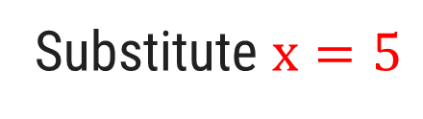
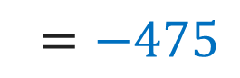
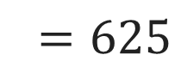
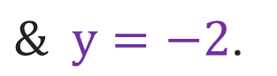
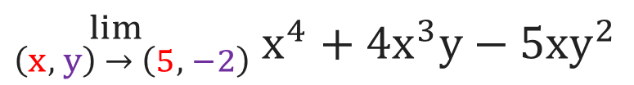
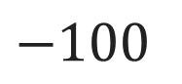
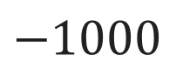
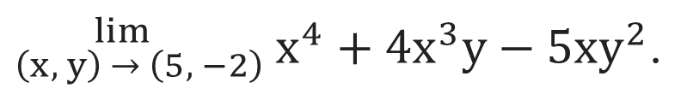
Example of Limit of Function of Two Variables $f\left(x, y\right)$
Example 1:
Evaluate
${}_{\left(x, y\right) → \left(5, −2\right)}^{ lim }{{ x}^{4} + 4x^{3}y−5xy^{2}}$.
Solution:
$${}_{\left(x, y\right) → \left(5, −2\right)}^{ lim }{{ x}^{4} + 4x^{3}y−5xy^{2}}$$
Substitute $x=5$
$$\& y=−2\text{.}$$
$${{=(5)}^{4}+ 4{\left(5\right)}^{3}(−2)−5\left(5\right){(−2)}^{2}}$$
$${{=(5)}^{4}+ 4{\left(5\right)}^{3}(−2)−5\left(5\right){(−2)}^{2}}$$
$${{=(5)}^{4}+ 4{\left(5\right)}^{3}(−2)−5\left(5\right){(−2)}^{2}}$$
$${=625}$$
$$−1000$$
$$−100$$
$${=−475}$$

Slide 7
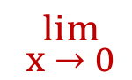
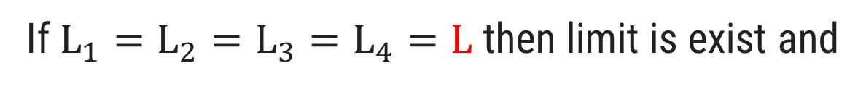
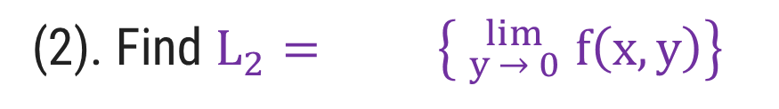
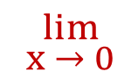
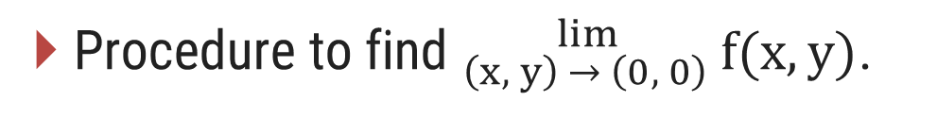
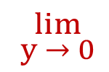
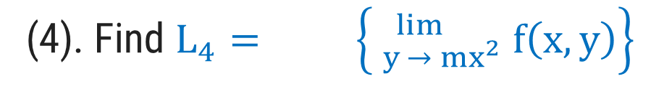
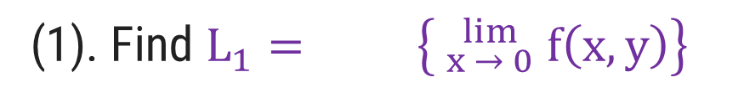
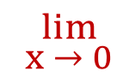
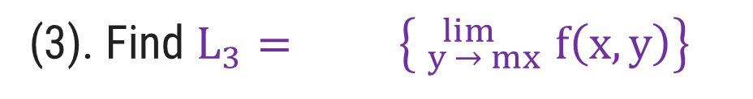
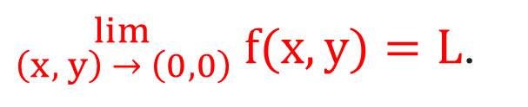
Limit of a function f(x, y) at point (0, 0)
Procedure to find ${}_{\left(x, y\right) → \left(0, 0\right)}^{ lim }{ f(x,y)}\text{.}$
$$_{y → 0}^{ lim}$$
(1). Find $L_{1}= \left\{ _{x → 0}^{ lim} f\left(x,y\right)\right\}$
$$_{x → 0}^{ lim}$$
(2). Find $L_{2}= \left\{ _{y → 0}^{ lim} f\left(x,y\right)\right\}$
$$_{x → 0}^{ lim}$$
(3). Find $L_{3}= \left\{ _{y → mx}^{ lim} f\left(x,y\right)\right\}$
(4). Find $L_{4}= \left\{ _{y → {mx}^{2}}^{ lim} f\left(x,y\right)\right\}$
$$_{x → 0}^{ lim}$$
${}_{\left(x, y\right) → \left(0, 0\right)}^{ lim }{ f(x,y)}=L$.
If $L_{1}=L_{2}=L_{3}=L_{4}=L$ then limit is exist and
If one of them is not equal to others then limit does not exist.

Slide 8
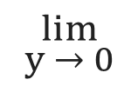
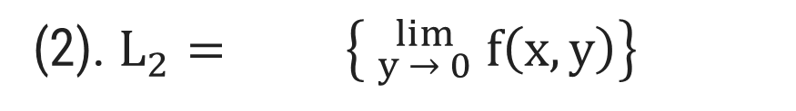
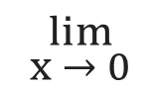
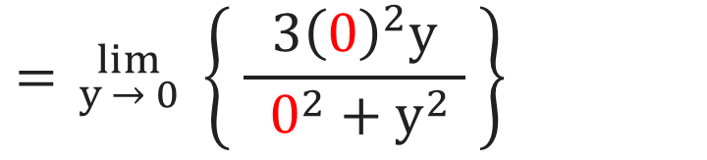
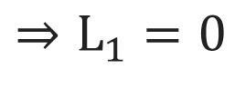
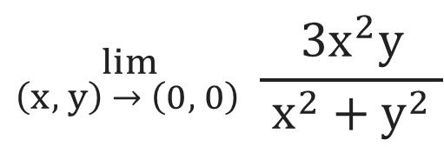
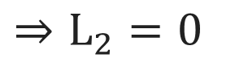
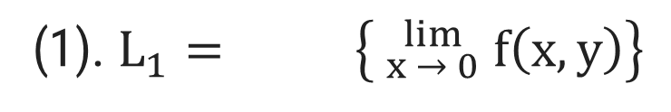
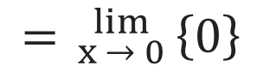
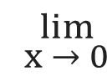
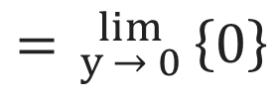
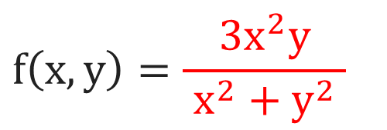
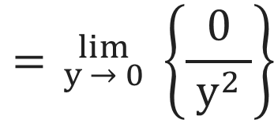
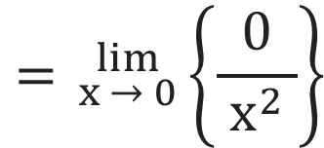
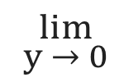
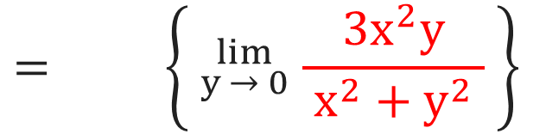
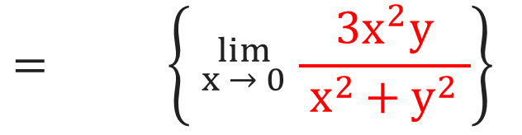
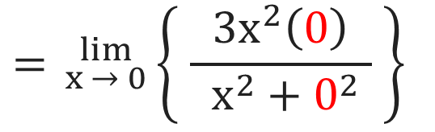
Example of Limit of Function of Two Variables at (0, 0)
$${}_{\left(x, y\right) → \left(0, 0\right)}^{ lim } \frac{3x^{2}y}{{ x}^{2} +{ y}^{2} }$$
$$f\left(x,y\right)=\frac{3x^{2}y}{{ x}^{2} +{ y}^{2} }$$
Example 2:
Find if it exist.
Solution:
$$_{y → 0}^{ lim}$$
$$_{x → 0}^{ lim}$$
(1). $L_{1}= \left\{ _{x → 0}^{ lim} f\left(x,y\right)\right\}$
(2). $L_{2}= \left\{ _{y → 0}^{ lim} f\left(x,y\right)\right\}$
$$= \left\{ _{x → 0}^{ lim} \frac{3x^{2}y}{{ x}^{2 }+ y^{2} }\right\}$$
$$= \left\{ _{y → 0}^{ lim} \frac{3x^{2}y}{{ x}^{2} +{ y}^{2} } \right\}$$
$$_{y → 0}^{ lim}$$
$$_{x → 0}^{ lim}$$
$$= _{y → 0}^{ lim} \left\{ \frac{3{\left(0\right)}^{2}y}{{ 0^{2}+y}^{2} } \right\}$$
$$= _{x → 0}^{ lim}\left\{ \frac{3x^{2}\left(0\right)}{{ x^{2}+0}^{2} } \right\}$$
$$= _{y → 0}^{ lim} \left\{\frac{0}{{ y}^{2} }\right\}$$
$$= _{x → 0}^{ lim}\left\{\frac{0}{ x^{2} }\right\}$$
$$= _{y → 0}^{ lim}\left\{0\right\}$$
$$= _{x → 0}^{ lim}\left\{0\right\}$$
$$⇒L_{1}=0$$
$$⇒L_{2}=0$$

Slide 9
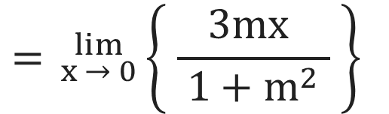
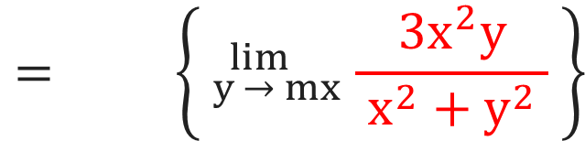
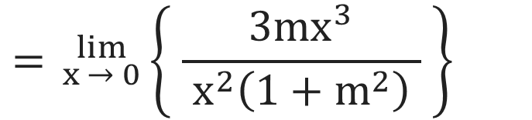
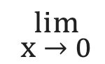
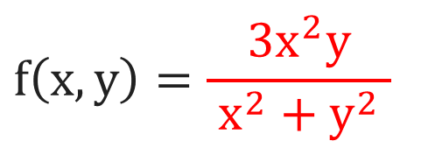
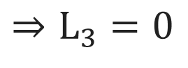
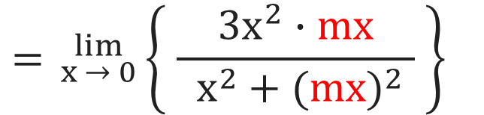
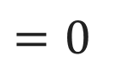
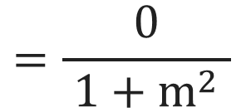
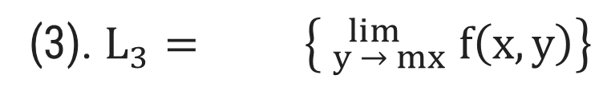
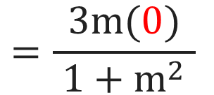
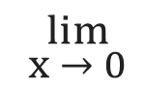
Example of Limit of Function of Two Variables at (0, 0)
$${}_{\left(x, y\right) → \left(0, 0\right)}^{ lim } \frac{3x^{2}y}{{ x}^{2} +{ y}^{2} }$$
$$f\left(x,y\right)=\frac{3x^{2}y}{{ x}^{2} + y^{2} }$$
Example 2:
Find if it exist.
Solution Continue:
$$= _{x → 0}^{ lim}\left\{ \frac{3{mx}^{ }}{ 1+m^{2} } \right\}$$
$$_{x → 0}^{ lim}$$
(3). $L_{3}= \left\{ _{y → mx}^{ lim} f\left(x,y\right)\right\}$
$$= \left\{ _{y → mx}^{ lim} \frac{3x^{2}y}{{ x}^{2} + y^{2} } \right\}$$
$$_{x → 0}^{ lim}$$
$$=\frac{3m(0)}{ 1+m^{2} }$$
$$= _{x → 0}^{ lim}\left\{ \frac{3x^{2}∙mx}{{ x}^{2} + {(mx)}^{2} } \right\}$$
$$=\frac{0}{ 1+m^{2} }$$
$$=0$$
$$= _{x → 0}^{ lim}\left\{ \frac{3{mx}^{3}}{{ x}^{2}\left(1+m^{2}\right) } \right\}$$
$$⇒L_{3}=0$$

Slide 10











Example of Limit of Function of Two Variables at (0, 0)
$${}_{\left(x, y\right) → \left(0, 0\right)}^{ lim } \frac{3x^{2}y}{{ x}^{2} +{ y}^{2} }$$
$$f\left(x,y\right)=\frac{3x^{2}y}{{ x}^{2} + y^{2} }$$
Example 2:
Find if it exist.
Solution Continue:
$$= _{x → 0}^{ lim}\left\{ \frac{3{{mx}^{2}}^{ }}{ 1+m^{2}x^{2} } \right\}$$
(4). $L_{4}= \left\{ _{y → {mx}^{2}}^{ lim} f\left(x,y\right)\right\}$
$$_{x → 0}^{ lim}$$
$$= \left\{ _{y → {mx}^{2}}^{ lim} \frac{3x^{2}y}{{ x}^{2} + y^{2} } \right\}$$
$$_{x → 0}^{ lim}$$
$$=\frac{3m{\left(0\right)}^{2}}{ 1+m^{2}{\left(0\right)}^{2} }$$
$$= _{x → 0}^{ lim}\left\{ \frac{3x^{2}∙{mx}^{2}}{{ x}^{2} + {\left(mx^{2}\right)}^{2} } \right\}$$
$$=\frac{0}{ 1 }=0$$
2
$$= _{x → 0}^{ lim}\left\{ \frac{3{mx}^{4}}{{ x}^{2}\left(1+m^{2}x^{2}\right) } \right\}$$
$$⇒L_{4}=0$$

Slide 11


Example of Limit of Function of Two Variables at (0, 0)
$${}_{\left(x, y\right) → \left(0, 0\right)}^{ lim } \frac{3x^{2}y}{{ x}^{2} +{ y}^{2} }$$
Example 2:
Find if it exist.
Solution Continue:
Here, $L_{1}=L_{2}=L_{3}=L_{4}=L=0\text{.}$
$$⇒\lim_{\left(x, y\right) → (0, 0)}{\frac{3x^{2}y}{{ x}^{2} + y^{2} }}=0$$

Slide 12

















Example of Limit of Function of Two Variables at (0, 0)
$$f\left(x, y\right)={\frac{2x^{2}y}{{ x}^{4} + y^{2} }}$$
Example 5:
Show that has no limit as $(x, y)$ approaches to $(0, 0)$.
Solution:
$$_{y → 0}^{ lim}$$
$$_{x → 0}^{ lim}$$
(1). $L_{1}= \left\{ _{x → 0}^{ lim} f\left(x,y\right)\right\}$
(2). $L_{2}= \left\{ _{y → 0}^{ lim} f\left(x,y\right)\right\}$
$$= \left\{ _{x → 0}^{ lim} \frac{2x^{2}y}{{ x}^{4} + y^{2} }\right\}$$
$$= \left\{ _{y → 0}^{ lim} \frac{2x^{2}y}{{ x}^{4} + y^{2} } \right\}$$
$$_{y → 0}^{ lim}$$
$$_{x → 0}^{ lim}$$
$$= _{y → 0}^{ lim}\left\{ \frac{0}{{ y}^{2} } \right\}$$
$$= _{x → 0}^{ lim}\left\{ \frac{0}{{ x}^{4} } \right\}$$
$$= _{y → 0}^{ lim}\left\{0\right\}$$
$$= _{x → 0}^{ lim}\left\{0\right\}$$
$$=0$$
$$=0$$
$$⇒L_{1}=0$$
$$⇒L_{2}=0$$

Slide 13











Example of Limit of Function of Two Variables at (0, 0)
$$f\left(x, y\right)={\frac{2x^{2}y}{{ x}^{4} +{ y}^{2} }}$$
Example 5:
Show that has no limit as $(x, y)$ approaches to $(0, 0)$.
Solution Continue:
$$= _{x → 0}^{ lim}\left\{ \frac{2{mx}^{ }}{ x^{2}+m^{2} } \right\}$$
$$_{x → 0}^{ lim}$$
(3). $L_{3}= \left\{ _{y → mx}^{ lim} f\left(x,y\right)\right\}$
$$= \left\{ _{y → mx}^{ lim} \frac{2x^{2}y}{{ x}^{4} + y^{2} } \right\}$$
$$_{x → 0}^{ lim}$$
$$=\frac{0}{ m^{2} }$$
$$= _{x → 0}^{ lim}\left\{ \frac{2x^{2}∙mx}{{ x}^{4} + {(mx)}^{2} } \right\}$$
$$=0$$
$$= _{x → 0}^{ lim}\left\{ \frac{2{mx}^{3}}{{ x}^{2}\left(x^{2}+m^{2}\right) } \right\}$$
$$⇒ L_{3}=0$$

Slide 14












Example of Limit of Function of Two Variables at (0, 0)
$$f\left(x, y\right)={\frac{2x^{2}y}{{ x}^{4} + y^{2} }}$$
Example 5:
Show that has no limit as $(x, y)$ approaches to $(0, 0)$.
Solution Continue:
(4). $L_{4}= \left\{ _{y → {mx}^{2}}^{ lim} f\left(x,y\right)\right\}$
$$= _{x → 0}^{ lim}\left\{ \frac{2m^{ }}{ 1+m^{2} } \right\}$$
$$_{x → 0}^{ lim}$$
$$= \left\{ _{y → {mx}^{2}}^{ lim} \frac{2x^{2}y}{{ x}^{4} + y^{2} } \right\}$$
$$_{x → 0}^{ lim}$$
$$=\frac{2m}{ 1+m^{2} }$$
$⇒L_{4}$ depends on m.
$$= _{x → 0}^{ lim}\left\{ \frac{2x^{2}∙{mx}^{2}}{{ x}^{4} + {\left(mx^{2}\right)}^{2}} \right\}$$
Hence, $L_{1}=L_{2}=L_{3}≠L_{4}$.
$$⇒\lim_{\left(x, y\right) → (0, 0)}{\frac{2x^{2}y}{{ x}^{4} + y^{2} }}does not exist\text{.}$$
$$= _{x → 0}^{ lim}\left\{ \frac{2{mx}^{4}}{{ x}^{4}\left(1+m^{2}\right) } \right\}$$

Slide 15
Method:2
Continuity of Function of Two Variables

Slide 16
Continuity of Function of Two Variables $f(x, y)$ at $\left(0, 0\right)$
Function $f(x, y$) is said to be continuous at point $(0, 0)$ if the following conditions
are satisfied.
$$_{y → 0}^{ lim}$$
(1). Find $L_{1}= \left\{ _{x → 0}^{ lim} f\left(x,y\right)\right\}$
$$_{x → 0}^{ lim}$$
$\text{(1).} f(0, 0)$ must be well define.
(2). Find $L_{2}= \left\{ _{y → 0}^{ lim} f\left(x,y\right)\right\}$
$$_{x → 0}^{ lim}$$
$$\lim_{\left(x, y\right) → (0, 0)}$$
(3). Find $L_{3}= \left\{ _{y → mx}^{ lim} f\left(x,y\right)\right\}$
$\text{(2).}{f(x,y)}$ must be exist.
(4). Find $L_{4}= \left\{ _{y → {mx}^{2}}^{ lim} f\left(x,y\right)\right\}$
$$_{x → 0}^{ lim}$$
$$\lim_{\left(x, y\right) → (0, 0)}$$
$\text{(3).}{f(x,y)}=f(0, 0)$.
$L_{1}=L_{2}=L_{3}=L_{4}=L$
Note: If one of the above three condition is not satisfied then
$f(x, y$) is not continuous at point $(0, 0)$.

Slide 17
Example of Continuity of Function of Two Variables at (0, 0)
Example 1:
Discuss the continuity of the function f defined as
$$f\left(x, y\right)=\left\{\begin{matrix}\frac{ x^{3}−y^{3} }{x^{2}+y^{2}} ;\left(x, y\right)≠(0, 0) \\ 0 ;\left(x, y\right)=(0, 0)\end{matrix}\text{.}\right.$$
Solution:
Here, $f\left(0, 0\right)=0\text{.}$
$\text{Condition} \text{1}: f(0, 0)$ must be well define.
$$⇒f is well defined at \left(0, 0\right)\text{.}$$

Slide 18
Example of Continuity of Function of Two Variables at (0, 0)
Example 1:
Discuss the continuity of the function f defined as
$$f\left(x, y\right)=\left\{\begin{matrix}\frac{ x^{3}−y^{3} }{x^{2}+y^{2}} ;\left(x, y\right)≠(0, 0) \\ 0 ;\left(x, y\right)=(0, 0)\end{matrix}\text{.}\right.$$
Solution Continue:
$\text{Condition}\text{ 2:}\lim_{\left(x, y\right) → (0, 0)}{f(x,y)}$ must be exist.
$$_{y → 0}^{ lim}$$
(1). $L_{1}= \left\{ _{x → 0}^{ lim} f\left(x,y\right)\right\}$
$$= _{y → 0}^{ lim}\left\{−y\right\}$$
$$= \left\{ _{x → 0}^{ lim} \frac{ x^{3}−y^{3} }{{ x}^{2} + y^{2} }\right\}$$
$$=0$$
$$_{y → 0}^{ lim}$$
$$⇒L_{1}=0$$
$$= _{y → 0}^{ lim}\left\{ \frac{ −y^{3} }{{ y}^{2} } \right\}$$

Slide 19
Example of Continuity of Function of Two Variables at (0, 0)
Example 1:
Discuss the continuity of the function f defined as
$$f\left(x, y\right)=\left\{\begin{matrix}\frac{ x^{3}−y^{3} }{x^{2}+y^{2}} ;\left(x, y\right)≠(0, 0) \\ 0 ;\left(x, y\right)=(0, 0)\end{matrix}\text{.}\right.$$
Solution Continue:
$$_{x → 0}^{ lim}$$
$$= _{x → 0}^{ lim}\left\{x\right\}$$
(2). $L_{2}= \left\{ _{y → 0}^{ lim} f\left(x,y\right)\right\}$
$$= \left\{ _{y → 0}^{ lim} \frac{ x^{3}−y^{3} }{{ x}^{2} + y^{2} }\right\}$$
$$=0$$
$$_{x → 0}^{ lim}$$
$$⇒L_{2}=0$$
$$= _{x → 0}^{ lim}\left\{ \frac{x^{3}}{{ x}^{2} } \right\}$$

Slide 20
Example of Continuity of Function of Two Variables at (0, 0)
Example 1:
Discuss the continuity of the function f defined as
$$f\left(x, y\right)=\left\{\begin{matrix}\frac{ x^{3}−y^{3} }{x^{2}+y^{2}} ;\left(x, y\right)≠(0, 0) \\ 0 ;\left(x, y\right)=(0, 0)\end{matrix}\text{.}\right.$$
Solution Continue:
$$_{x → 0}^{ lim}$$
$$= _{x → 0}^{ lim}\frac{ x^{3}\left(1−m^{3}\right) }{x^{2}(1+m^{2})}$$
(3). $L_{3}= \left\{ _{y → mx}^{ lim} f\left(x,y\right)\right\}$
$$= \left\{ _{y → mx}^{ lim} \frac{ x^{3}−y^{3} }{{ x}^{2} + y^{2} }\right\}$$
$$_{x → 0}^{ lim}$$
$$= _{x → 0}^{ lim}\frac{ x (1−m^{3})}{ (1+m^{2})}$$
$$= _{x → 0}^{ lim}\left\{ \frac{ x^{3}−{\left(mx\right)}^{3}}{{ x}^{2} +{ \left(mx\right)}^{2}} \right\}$$
$$=0$$
$$⇒L_{3}=0$$

Slide 21
Example of Continuity of Function of Two Variables at (0, 0)
Example 1:
Discuss the continuity of the function f defined as
$$f\left(x, y\right)=\left\{\begin{matrix}\frac{ x^{3}−y^{3} }{x^{2}+y^{2}} ;\left(x, y\right)≠(0, 0) \\ 0 ;\left(x, y\right)=(0, 0)\end{matrix}\text{.}\right.$$
Solution Continue:
(4). $L_{4}= \left\{ _{y →{ mx}^{2}}^{ lim} f\left(x,y\right)\right\}$
$$= _{x → 0}^{ lim}\frac{{ x}^{3}\left(1−m^{3}x^{3}\right) }{ x^{2}\left(1+m^{2}x^{2}\right) }$$
$$_{x → 0}^{ lim}$$
$$= \left\{ _{y → {mx}^{2}}^{ lim} \frac{ x^{3}−y^{3} }{ x^{2}+y^{2} }\right\}$$
$$_{x → 0}^{ lim}$$
$$= _{x → 0}^{ lim}\frac{ x (1−m^{3}x^{3})}{ (1+m^{2}x^{2})}$$
$$= _{x → 0}^{ lim}\left\{ \frac{ x^{3}−{\left({mx}^{2}\right)}^{3}}{{ x}^{2} +{ \left(mx^{2}\right)}^{2} } \right\}$$
$$=0$$
$$⇒L_{4}=0$$

Slide 22
Example of Continuity of Function of Two Variables at (0, 0)
Example 1:
Discuss the continuity of the function f defined as
$$f\left(x, y\right)=\left\{\begin{matrix}\frac{ x^{3}−y^{3} }{x^{2}+y^{2}} ;\left(x, y\right)≠(0, 0) \\ 0 ;\left(x, y\right)=(0, 0)\end{matrix}\text{.}\right.$$
Solution Continue:
Here, $f(0, 0)=L=0.$
Here, $L_{1}=L_{2}=L_{3}=L_{4}=L=0$.
$\text{Condition}\text{ 3:} \lim_{\left(x, y\right) → (0, 0)}{f(x,y)}=f\left(0, 0\right)$.
$$⇒\lim_{\left(x, y\right) → (0, 0)}{\frac{ x^{3} −{ y}^{3} }{{ x}^{2} + y^{2} }}=0$$
Hence, all three conditions are satisfied$\text{.}$
$⇒f(x, y)$ is continuous at $\left(0, 0\right)\text{.}$

Slide 23
Example of Continuity of Function of Two Variables at (0, 0)
Example 1*:
Discuss the continuity of the function f defined as
$$f\left(x, y\right)=\left\{\begin{matrix}\frac{ x^{3}−y^{3} }{x^{2}+y^{2}} ;\left(x, y\right)≠(0, 0) \\ ;\left(x, y\right)=(0, 0)\end{matrix}\text{.}\right.$$
$$2$$
$$0$$
Solution:
$\text{1}: f(0, 0)$ must be well define.
$$∵f\left(0, 0\right)=2$$
$\text{2:}\lim_{\left(x, y\right) → (0, 0)}{f(x,y)}$ must be exist.
$$∵\lim_{\left(x, y\right) → (0, 0)}{f\left(x, y\right)}=0$$
$\text{3:} \lim_{\left(x, y\right) → (0, 0)}{f(x,y)}=f\left(0, 0\right)$.
$$∵0≠2$$
Hence, third condition is not satisfied$\text{.}$
$⇒f(x, y)$ is not continuous at $\left(0, 0\right)\text{.}$

Slide 24
Example of Continuity of Function of Two Variables at (0, 0)
Example 5:
Show that the following function is not continuous at origin.
$$f\left(x, y\right)=\left\{ \begin{matrix}\frac{2x^{2}y}{ x^{3}+y^{3} } ;\left(x, y\right)≠(0, 0) \\ 0 ;\left(x, y\right)=(0, 0)\end{matrix}\text{.}\right.$$
Solution:
Here, $f\left(0, 0\right)=0\text{.}$
$\text{Condition} \text{1}: f(0, 0)$ must be well define.
$$∴f is well defined at \left(0, 0\right)\text{.}$$

Slide 25
Example of Continuity of Function of Two Variables at (0, 0)
Example 5:
Show that the following function is not continuous at origin.
$$f\left(x, y\right)=\left\{ \begin{matrix}\frac{2x^{2}y}{ x^{3}+y^{3} } ;\left(x, y\right)≠(0, 0) \\ 0 ;\left(x, y\right)=(0, 0)\end{matrix}\text{.}\right.$$
Solution Continue:
$$= _{y → 0}^{ lim}\left\{ \frac{0}{{ y}^{3} } \right\}$$
$\text{Condition}\text{ 2:}\lim_{\left(x, y\right) → (0, 0)}{f(x,y)}$ must be exist.
$$_{y → 0}^{ lim}$$
(1). $L_{1}= \left\{ _{x → 0}^{ lim} f\left(x,y\right)\right\}$
$$= \left\{ _{x → 0}^{ lim} \frac{2x^{2}y}{{ x}^{3} + y^{3} }\right\}$$
$$=0$$
$$_{y → 0}^{ lim}$$
$$⇒L_{1}=0$$

Slide 26
Example of Continuity of Function of Two Variables at (0, 0)
Example 5:
Show that the following function is not continuous at origin.
$$f\left(x, y\right)=\left\{ \begin{matrix}\frac{2x^{2}y}{ x^{3}+y^{3} } ;\left(x, y\right)≠(0, 0) \\ 0 ;\left(x, y\right)=(0, 0)\end{matrix}\text{.}\right.$$
Solution Continue:
$$_{x → 0}^{ lim}$$
$$=0$$
(2). $L_{2}= \left\{ _{y → 0}^{ lim} f\left(x,y\right)\right\}$
$$⇒L_{2}=0$$
$$= \left\{ _{y → 0}^{ lim}\frac{2x^{2}y}{{ x}^{3} + y^{3} }\right\}$$
$$_{x → 0}^{ lim}$$
$$= _{x → 0}^{ lim}\left\{ \frac{0}{{ x}^{3} } \right\}$$

Slide 27
Example of Continuity of Function of Two Variables at (0, 0)
Example 5:
Show that the following function is not continuous at origin.
$$f\left(x, y\right)=\left\{ \begin{matrix}\frac{2x^{2}y}{ x^{3}+y^{3} } ;\left(x, y\right)≠(0, 0) \\ 0 ;\left(x, y\right)=(0, 0)\end{matrix}\text{.}\right.$$
Solution Continue:
$$_{x → 0}^{ lim}$$
$$= _{x → 0}^{ lim}\frac{2mx^{3}}{ x^{3}\left(1+m^{3}\right) }$$
(3). $L_{3}= \left\{ _{y → mx}^{ lim} f\left(x,y\right)\right\}$
$$= \left\{ _{y → mx }^{ lim}\frac{2x^{2}y}{{ x}^{3} + y^{3} }\right\}$$
$$_{x → 0}^{ lim}$$
$$=\frac{2m}{ 1+m^{3} }$$
(Which depends on m)
$$= _{x → 0}^{ lim}\left\{\frac{2x^{2}∙mx}{{ x}^{3} + m^{3}x^{3} }\right\}$$
Hence, $L_{1}=L_{2}≠L_{3}\text{.}$

Slide 28
Example of Continuity of Function of Two Variables at (0, 0)
Example 5:
Show that the following function is not continuous at origin.
$$f\left(x, y\right)=\left\{ \begin{matrix}\frac{2x^{2}y}{ x^{3}+y^{3} } ;\left(x, y\right)≠(0, 0) \\ 0 ;\left(x, y\right)=(0, 0)\end{matrix}\text{.}\right.$$
Solution Continue:
$$⇒\lim_{\left(x, y\right) → (0, 0)}{\frac{2x^{2}y}{{ x}^{3} + y^{3} }does not exist\text{.}}$$
Here, second condition is not satisfied$\text{.}$
$⇒f\left(x, y\right)$ is not continuous at $\left(0, 0\right)$.

Slide 29
Mathematics-I (M-I)
GTU # 3110014
THANK YOU
Prof. Darshan R. Pipaliya
Humanities & Science Department
darshan.pipaliya@darshan.ac.in
918160597689

